Slide 1
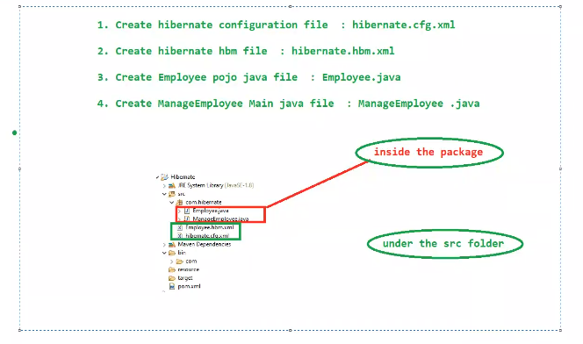
Hibernate

Slide 2
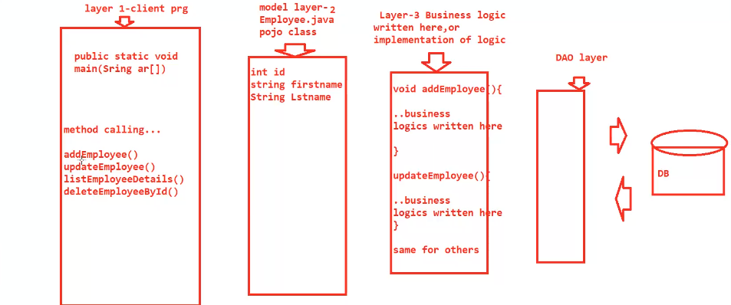

Slide 3
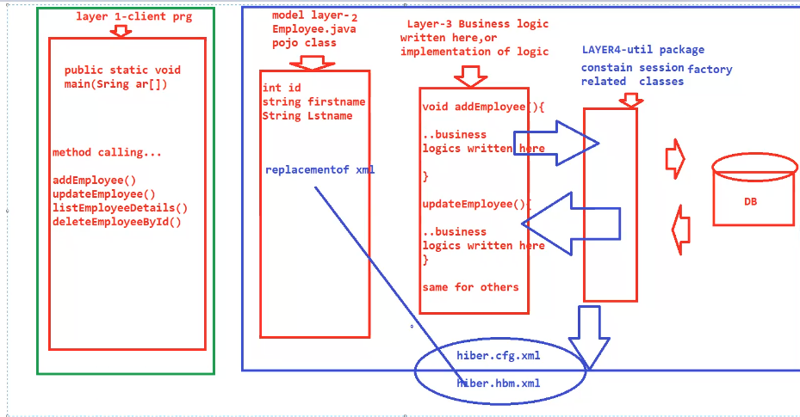
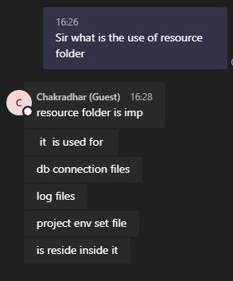

Slide 4
Hibernate dependencies
<dependencies>
<!-- API, java.xml.bind module -->
<dependency>
<groupId>jakarta.xml.bind</groupId>
<artifactId>jakarta.xml.bind-api</artifactId>
<version>2.3.2</version>
</dependency>
<!-- Runtime, com.sun.xml.bind module -->
<dependency>
<groupId>org.glassfish.jaxb</groupId>
<artifactId>jaxb-runtime</artifactId>
<version>2.3.2</version>
</dependency>

Slide 5
